Slide 1
Bundle-Bid
https://github.com/scottsun17/BundleBid

Slide 2
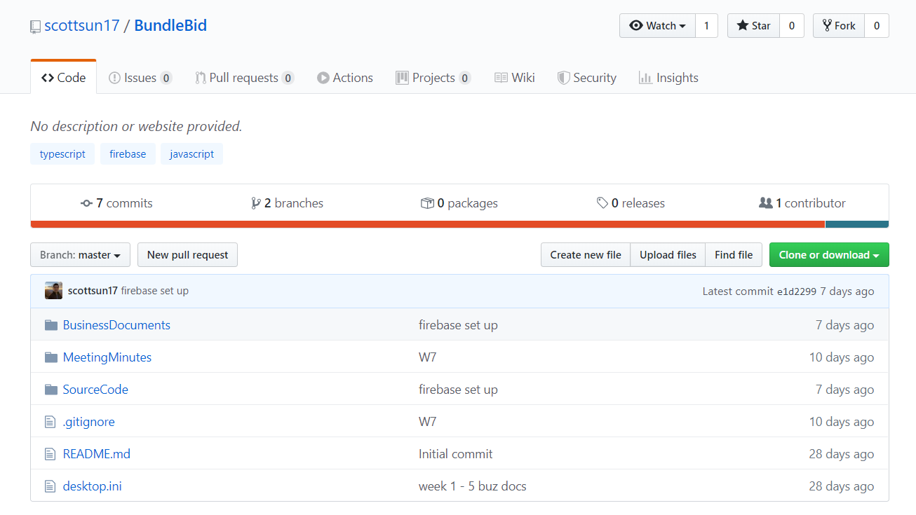
Screenshots

Slide 3
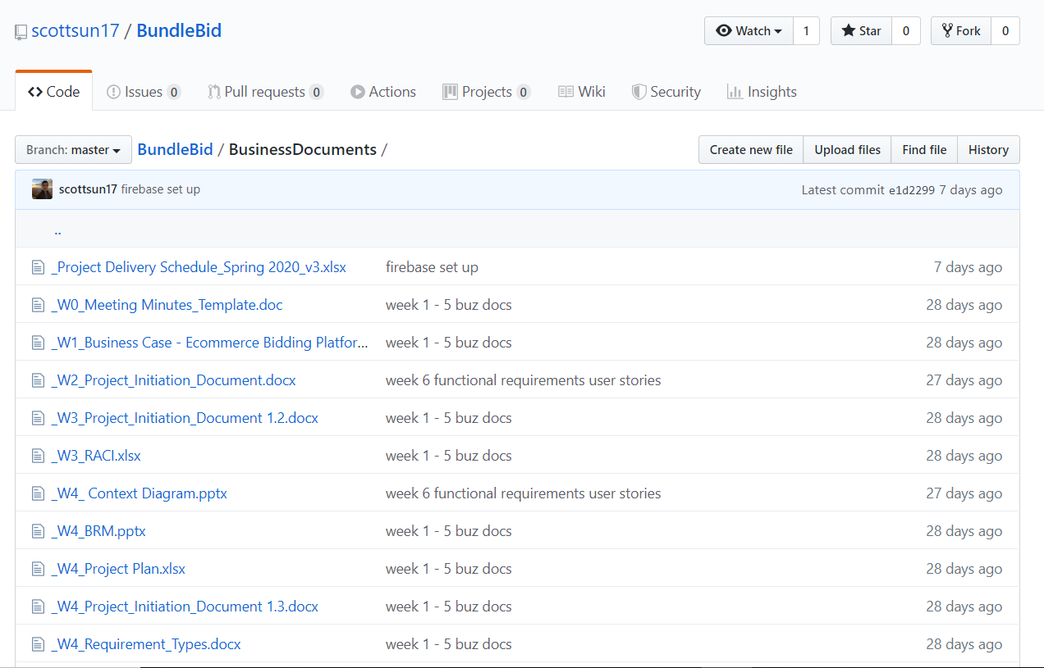

Slide 4
